Slide 1
and the natural world

Slide 2
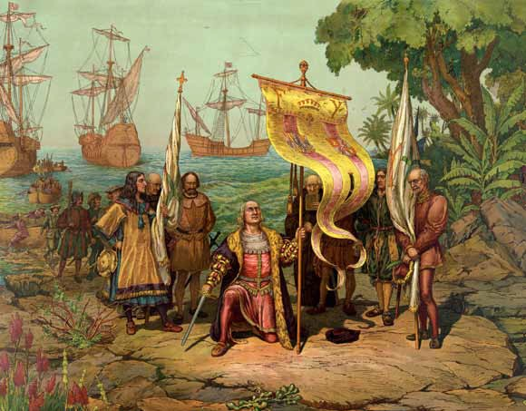
Voyages of Discovery (c1400-1600s)
Hundreds of years ago people explored, exploited and colonised large parts of the world
Explorers made long dangerous journeys on wooden ships
Natural historians discovered new plants to study scientifically or for food and medicine
Christopher Columbus arriving in America (1893, L. Prang & Co., Boston)
Notes:
Hundreds of years ago people explored, exploited and colonised large parts of the world.
Explorers made long dangerous journeys on small wooden ships.
Natural historians joined the race to discover new plants to bring back to Europe to study scientifically or for food and medicine.

Slide 3
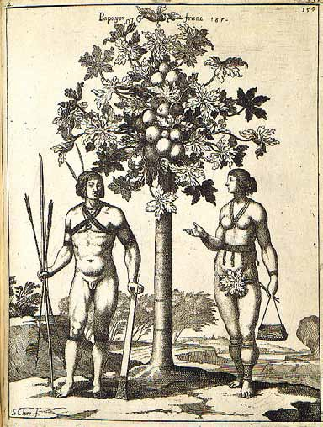
Why enslave Africans?
Wars or disease killed many original people in the Americas and European servants
African people were enslaved to work on plantations in the Caribbean and America
The crops that grew there made huge profits for Europeans
One of the earliest recorded examples of life in the Caribbean, Jean Baptiste Du Tertre, 1610–1687
Notes:
Many original people in the Americas and European servants died through wars or diseases.
African people were enslaved to work on plantations in the Caribbean and America.
The crops that grew there were in demand and made huge profits for Europeans.

Slide 4
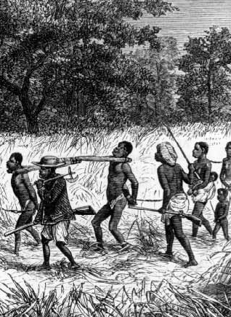
Scale of the trade
The transatlantic slave trade lasted over 300 years
Historians estimate that 10-15 million people were taken from Africa by force
Other estimates say many more millions of Africans were taken
Many African people tried to stop the trade but Europeans had guns and more power
Africans took few possessions, except their skills, knowledge and ideas and sometimes a few seeds
Captured Africans being forced to march to the coast for sale to Europeans © Anti-Slavery International
Notes:
The transatlantic slave trade lasted over 300 years.
Historians estimate that 10-15 million people were taken from Africa to the Americas by force.
Other estimates put the numbers as high as 100 million.
Many African people tried to stop the trade but Europeans had guns and more power.
African people took few possessions, except their skills, knowledge and ideas and sometimes a few seeds.

Slide 5
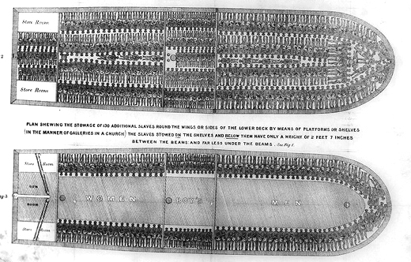
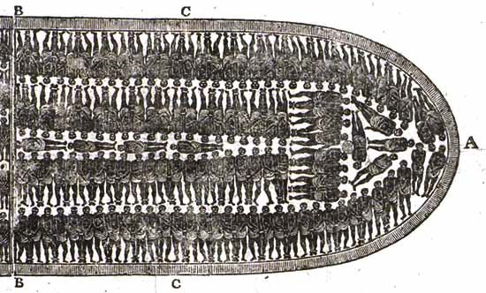
Transport across the Atlantic
African people were taken to the Caribbean and America on ships
The journey was terrible and lasted six to eight weeks
People were chained in a space 40 cm wide
They could not sit up fully or stand
Equiano was an African captured as a child. He later wrote a book about his experiences
Plan of the slaving ship, The Brookes, first published 1789
Notes:
Hundreds of African people were crowded into ships and taken to the Caribbean and America.
The journey lasted six to eight weeks in terrible conditions.
People were chained in a space 40 cm wide and could not sit up fully or stand.
Equiano was an African who was captured as a child and wrote:
‘The closeness of the place, and the heat of the climate, added to the number in the ship, which was so crowded that each had scarcely room to turn himself, almost suffocated us. This produced copious perspirations, so that the air soon became unfit for respiration, from a variety of loathsome smells, and brought on a sickness among the slaves, of which many died...
This wretched situation was again aggravated by the galling of the chains, now become insupportable; and the filth of the necessary tubs, into which the children often fell, and were almost suffocated. The shrieks of the women, and the groans of the dying, rendered the whole a scene of horror almost inconceivable.’

Slide 6
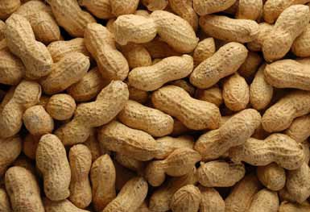
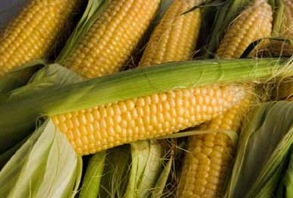
Food on board ship
Food on slaving ships was often peanuts and maize (from South America)
Drinking water was often dirty and caused many illnesses
Enslaved Africans had to eat from the same bowls and could not wash easily
Many died of dysentery
At least 1.25 million Africans died crossing the Atlantic
Africans often resisted enslavement by refusing to eat, starting revolts or suicide
Top: peanuts
Bottom: sweetcorn/maize
Notes:
Food on slaving ships was often peanuts and maize which originally came from South America. Drinking water was often dirty and caused many illnesses.
Enslaved Africans had to eat from the same bowls and could not wash easily. Many died of dysentery. Ships’ documents show at least 1.25 million Africans died crossing the Atlantic.
Africans often resisted capture and enslavement by refusing to eat or starting revolts in protest. Some chose suicide.
Equiano wrote:
‘I was soon put down under the decks, and there I received such a salutation in my nostrils as I had never experienced in my life: so that with the loathsomeness of the stench and crying together, I became so sick and low that I was not able to eat, nor had I the least desire to taste anything.’

Slide 7
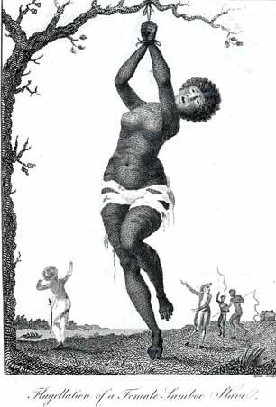
On the plantations
Many enslaved Africans worked on plantations growing crops such as sugar, rice and cotton
A third of all enslaved Africans died in their first three years in the Caribbean
Punishments were common – people were whipped, tortured and sometimes branded with hot irons
Africans often tried to escape slavery; some succeeded but others were punished even more
However, they still kept aspects of their culture and spirit alive
Left: William Blake’s illustration of the torture of a female slave, from John Gabriel Stedman, Narrative of a Five Years Expedition Against the Revolted Negroes of Surinam , 1796
Notes:
Many enslaved Africans worked on plantations growing crops such as sugar, rice and cotton. Life on the plantations was very hard and a third of all enslaved Africans died in their first three years in the Caribbean. Punishments were common – people were whipped, tortured and sometimes branded with hot irons.
Many African people tried to escape slavery; some were successful but those who were caught were punished even more.
In spite of this, African people in the Americas kept aspects of their culture, spirit and determination alive.
The natural historian Hans Sloane wrote:
‘For Negligence, they are usually whipt by the Overseers with Lance-wood switches, till they be bloody, and several of the Switches broken… After they are whip’d till they are Raw, some put on their Skins Pepper and Salt to make them smart; at other times their Masters will drop melted Wax on their Skins.’

Slide 8
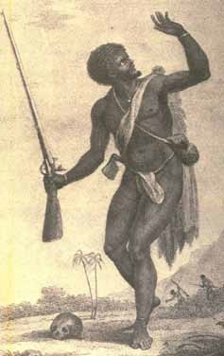
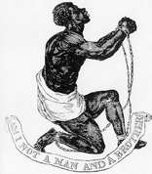
Abolition and freedom
Many African and European people campaigned to end slavery
Europeans typically showed Africans begging to be released
But in reality many Africans, especially Maroons, actively resisted slavery
They poisoned the slavers and fought against them
Slavery only ended in the Americas at the end of the 1800s, but racial inequalities continued
Forms of slavery still exist in parts of the world today
Left: Armed Maroon by William Blake, from Stedman, 1796
Right: Official medallion of the British Anti-Slavery Society, designed by the Wedgwood factory
Notes:
Many African as well as European people campaigned to end slavery.
Europeans typically showed Africans begging to be released, but in reality many Africans actively resisted slavery. They poisoned those who enslaved them and fought against them. A group of escaped enslaved Africans called Maroons were particularly successful at fighting slavery.
Slavery only ended in the Americas at the end of the 1800s; but racial inequalities continue to the present day. Forms of slavery still exist in different parts of the world today.

Slide 9
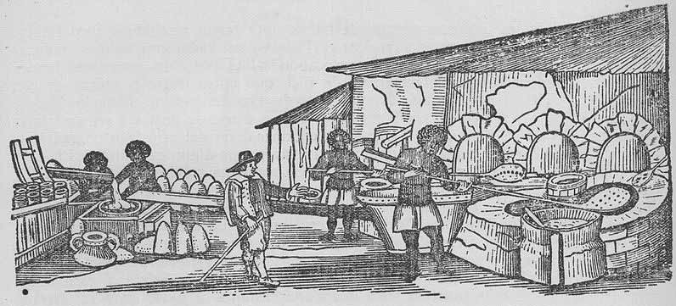
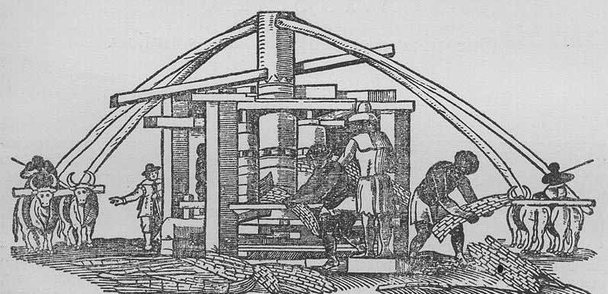
Daily life
Enslaved Africans were woken at 4.00am
They often worked from 6 in the morning until 6 at night, six days a week
The food given to enslaved Africans was very basic
The ration was about 1.36 kgs of dried meat and about 6 kg of corn for an adult for a week
Early illustrations of sugar milling and extraction, Piso, 1648
Notes:
Enslaved Africans were woken at 4.00am, and often worked from 6 in the morning until 6 at night; six days a week.
The food given to enslaved Africans varied from place to place and over time but was very basic. The ration was usually about 1.36 kilograms (three pounds) of dried meat and a ‘peck’ of corn (which is about six kilograms) for an adult for a week, and it was given out on Sundays.
Solomon Northrup who was enslaved in America wrote:
‘All that is allowed them is corn and bacon, which is given out at the corncrib and smoke-house every Sunday morning. Each one receives, as his weekly allowance, three and a half pounds of bacon, and corn enough to make a peck of meal. That is all – no tea, coffee, sugar, and with the exception of a very scanty
sprinkling now and then, no salt…’

Slide 10
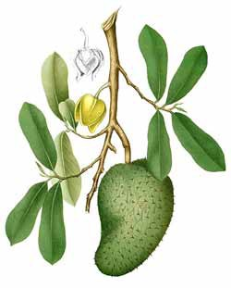
Provision grounds
Enslaved Africans had to grow their own food
They grew okra and rice – plants that they grew in Africa
They used their skills and knowledge to survive
They collected wild foods such as fruits, nuts and fish to survive
These provided vitamins and minerals as well as extra protein
Fresh fruit and vegetables provided vitamin C and animals were important sources of protein
Top: Okra
Bottom: Soursop, illustration from the Natural History Museum collections
Notes:
Enslaved Africans were made to grow their own food. They grew okra and rice – plants that they grew in Africa. They used their
skills and knowledge to survive.
Many enslaved people used their knowledge of plants and the land, to collect wild foods such as fruits, nuts, and fish. These additional foods really improved the diet of enslaved people.
They provided vitamins and minerals as well as extra protein. Fresh fruit and vegetables provided vitamin C and animals were important sources of protein.
The natural historian Patrick Browne wrote about rats:
‘Numbers of the negroes roast these animals in the stoke-holes, and eat them; and I have been informed by men of character, who have tasted of them, that they are very delicate meat.’

Slide 11
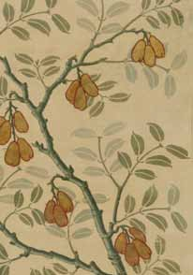
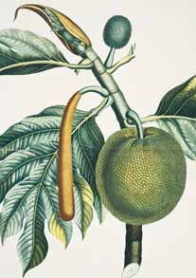
Breadfruit and ackee
Breadfruit is high in carbohydrate
It was taken from Tahiti in the Pacific to the Caribbean to feed enslaved people cheaply
The first journey ended in William Bligh’s mutiny on the Bounty
He succeeded on his second voyage
Breadfruit is now a staple food in many tropical regions
Bligh took hundreds of plants from Jamaica for the botanist Joseph Banks
One of these was the fruit ackee – part of Jamaica’s national dish ‘ackee and saltfish’
Left: Ackee, illustration from a ceiling decoration at the Natural History Museum Right: Breadfruit, illustration from the Natural History Museum collections
Notes:
Breadfruit is high in carbohydrate. It originated in Tahiti in the Pacific and was taken to the Caribbean to feed enslaved
people cheaply.
William Bligh’s first breadfruit journey ended in the mutiny on the Bounty. He only succeeded on his second voyage. Breadfruit is now a staple food in many tropical regions.
When Bligh left Jamaica he took hundreds of plants for the botanist Joseph Banks. One of these was the fruit ackee, now a part of the national dish of Jamaica, ‘ackee and saltfish’. ‘[ackee was] … brought here in a Slave Ship from the Coast of Africa, and now grows very luxuriant, producing every Year large Quantities of fruit’.

Slide 12
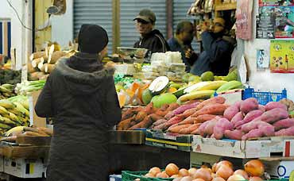
Legacies
Soul food is the traditional cooking of African-Americans in the Southern US where slavery was common
Soul food can be traced back to Africa
Rice, sorghum and okra from Africa went to the Americas during the slave trade
Enslaved people also used cheap foods with little waste
Soups and stews were boiled over and over again
Fried foods, foods rich in salt and well cooked vegetables are linked to diet at the time of slavery
Caribbean vegetables on sale at Brixton Market, London
© Copyright Alex Munro
Notes:
Soul food is the traditional cooking of African-Americans in the Southern United States where slavery was common. The origins of soul food can be traced back to Africa.
Rice, sorghum and okra were all West African and were introduced to the Americas as a result of the slave trade.
Enslaved people also used cheap foods with little waste. Soups and stews were boiled over and over again.
Fried foods, foods rich in salt and well cooked vegetables are linked to the diet at the time of slavery.

Slide 13
Natural History Museum Cromwell Road
London SW7 5BD, UK.
+44 (0)20 7942 5000
www.nhm.ac.uk

