Slide 1
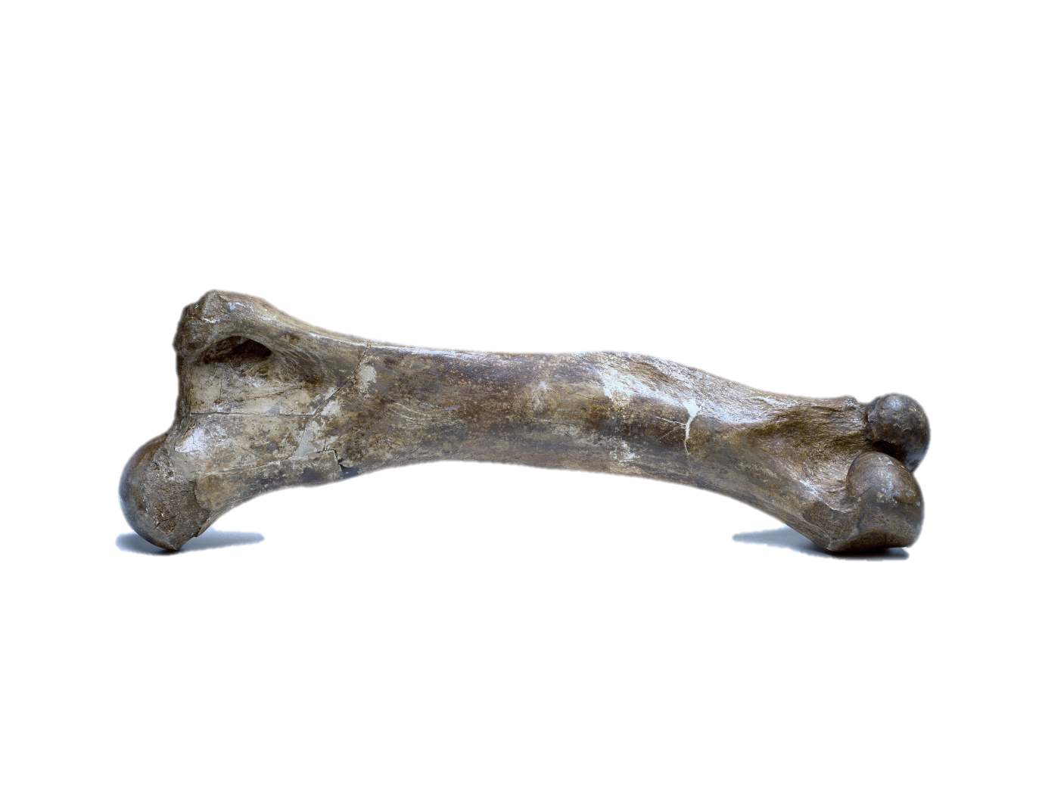
Mary Anning’s Fossil Challenge!
Image credits:
Mary Anning and fossil images © The Trustees of the Natural History Museum, London Plesiosaur still from 3D model (slide nine): Juan Pablo

Slide 2
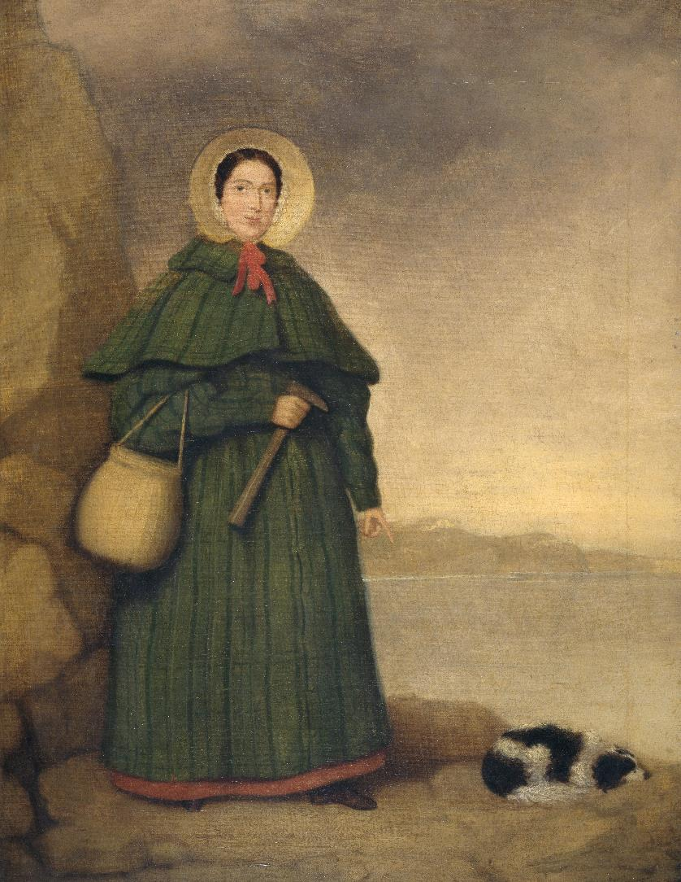
Famous Palaeontologist Mary Anning…
Is uncovering a fossil, bit by bit, with her rock hammer and her brush. Let’s help her by describing what we see, comparing parts to our own bodies and coming up with some ideas!
Image credit: The Natural History Museum, London Original painting: Artist unknown, Copyright Undetermined
Notes:
Famous Palaeontologist, Mary Anning, lived a long time ago, around two hundred years in the past, in a place by the sea called Lyme Regis.
Mary had a hard life and was from a poor family. She had to work hard, exploring along the seaside cliffs to find fossils. It was not always easy work, but she was interested, curious, adventurous, and determined!
Mary Anning found important clues about the way life was millions of years in the past! Where were those clues? In the rocks. What was that evidence? The fossils.

Slide 3
Mary has found one of these! Here we can see what it looks like from the top and from the side.

Slide 4
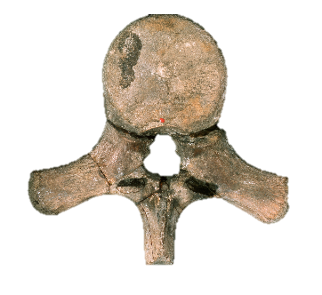
Mary Anning has found lots of bones shaped like this:
When all these bones are together, they look like this:

Slide 5
Mary has found some bones that fit together like this:
Notes:
Mary has found four of these.

Slide 6
This is Mary Anning's fossil, one of the first skeletons of this animal that scientists had ever seen! Many of the bones were spread out, like a broken-up puzzle.

Slide 7
Fossil: Plesiosaur
Plesiosaurs were NOT dinosaurs
Here are some of the things that scientists think
about plesiosaurs today!
Plesiosaurs were marine reptiles
Plesiosaurs were carnivorous animals
They lived and swam in the oceans of Earth
Plesiosaurs are extinct
They were alive over 150 million years ago

Slide 8
Well done! You have completed Mary Anning’s Fossil Challenge!
You are excellent trainee palaeontologists!
Notes:
Even nearly 200 years since Mary Anning lived, we still don’t know everything about the ancient world. Palaeontologists today are still making exciting discoveries which help us understand life on our planet. Maybe you will discover something amazing, just like Mary Anning.

Slide 9
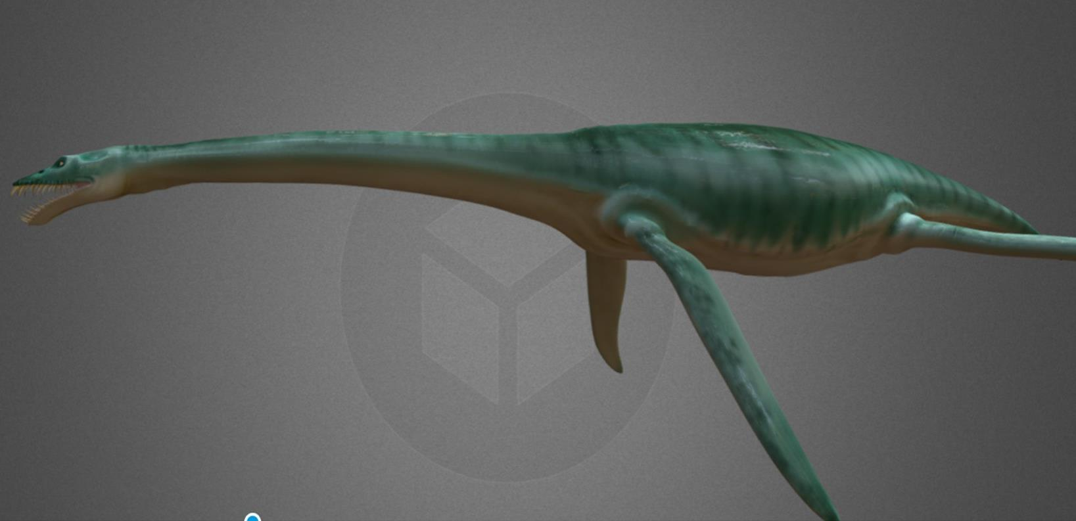
Image: Juan Pablo - ‘Living’ Plesiosaurus: plesiosaur still from 3D model

